Slide 1
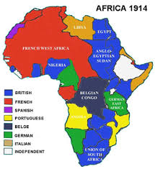
Imperialism and Colonization of Africa
Lesson 1
Intro & Factors

Slide 2
Next year do an activity pretending to have students sit at the Berlin Conference and divide up Africa

Slide 3
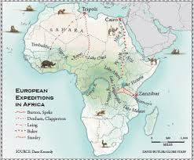
Colonization of Africa
In 1850 Europe knew very little about Africa, by 1914 Europe had taken control over almost all of the continent.
How do you think Europe took control of Africa?
By Force
Why would Europe want to colonize Africa?
For the resources
Which resources were the most sought after?
Minerals, ivory, wood, cotton, rubber, coffee, sugar cane, peanuts, pepper and spices
Which European countries were the main colonizers?
United Kingdom, France, Belgium and Germany
How do you think Africa was divided up?
Fighting & The Colonial powers sat together in Berlin and drew the borders on a map (Berlin Conference)

Slide 4
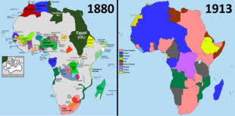
Let’s take a step back… What was the Context of the European Colonization of Africa?
Nationalist Movements
Abolition of Slavery
Renewal of Colonization
READ page 142-144 as a class

Slide 5
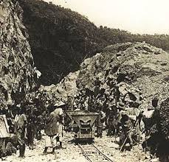
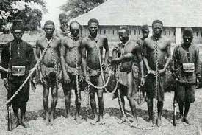
Colonial Imperialism: Factors in Colonization 1. Economic
Economic Reasons
Industrial Revolution created a new need for raw materials
Industrialized countries needed cotton, rubber, wood, etc.
Found these resources in Africa
Africa was also a perfect place to sell their surplus production
Colonizers had new technology and money to build railways and sturdy ships to get materials out and bring manufactured goods in
Why do you think it was only after the Industrial Revolution that Colonizing Africa was possible?
Crash Course 3:35-6:22

Slide 6
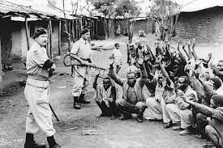
Colonial Imperialism: Factors in Colonization 2. Demographic (Population)
Europe’s population doubled in 19th century
180 million to 400 million
Drove Europe to expand their colonial empires
Many Europeans migrated to new territory
40 million settled in colonies eg. South Africa

Slide 7
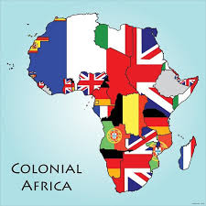
Colonial Imperialism: Factors in Colonization 3. Political
Industrial countries were in competition with each other
Increase their Nationalism
They were already competing elsewhere in the world so Africa seemed the likely next location
Great Britain, France, Belgium, Germany and Italy

Slide 8
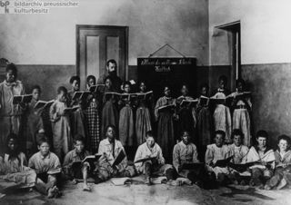
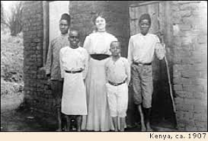
Colonial Imperialism: Factors in Colonization 4. Cultural
Europeans believed that Western Civilization was superior to all other.
They believed they were in charge of civilizing the world
“Civilizing Mission” -Spread the culture, even by force
Mandated hundreds of missionaries, teachers, doctors and officials to ‘fix the barbarians’

Slide 9
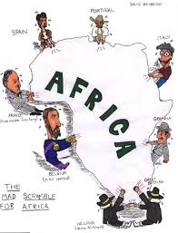
HOMEWORK: We have already read 142-144 Now complete page 145-146 #1-10
The Scramble for Africa

Slide 10
Imperialism and Colonization of Africa
Lesson 2
The Berlin Conference
The Scramble for Africa

Slide 11
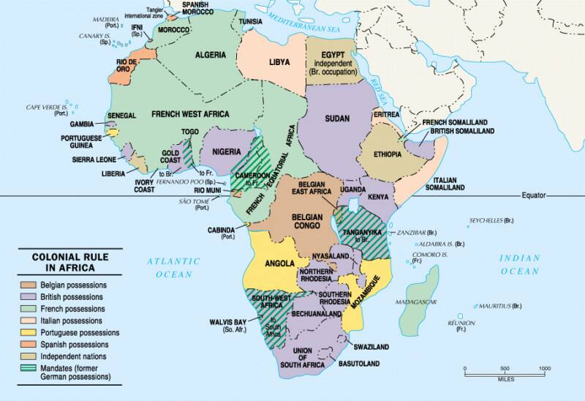

Slide 12
States of Independence: The Scramble for Africa
How Africa was colonized
The problems associated
0-20:00
Handout provided #1-9

Slide 13
Read 148-149 in Workbook
Complete page 150-151 #1, 2, 4, 5, 10
Why were Ethiopia and Liberia not colonized?

Slide 14
Imperialism and Colonization of Africa
Lesson 3
Effects of colonization

Slide 15
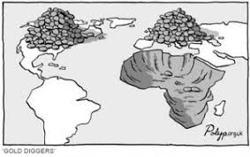
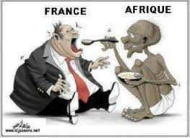
The Effects of Colonization in Africa Read page 152-152
How did Racial Discrimination Play a roll in the colonization of Africa?
How did the colonial pact benefit Europeans?

Slide 16
The Effects if European Imperialism
Read page 160-1

Slide 17
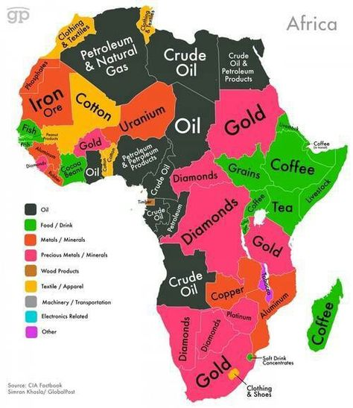
The Effects of Colonization on the Africa People
Economic: Profit to Europe at the expense of Africa
Colonial Pact:
Sell raw materials to mother country, buy back manufactured goods
Africans forced to buy goods made in Mother Country (put local artisans out of work)
Colony could only trade with Mother Country (eg. Only sell diamonds to Britain, not negotiate with rest of world)
Africans who refused assimilation or colonization, but evaded death, were burdened with force labour
Railways and canals were built across the continent- what do you think the canals and railways connected?
Plantations and mines to ports (to get raw materials out)
When Europe left Africa (decolonized) Africa had no manufacturing infrastructure, no industry and no capital

Slide 18
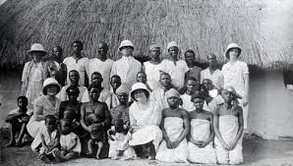
Effects of Colonization on the Africa People
Cultural Effects: adopting European culture meant the loss of African culture
African converted to Christianity
Africans attended schools built by Europeans and learned the language, history and way of life of the mother country
France tried to assimilate their colonies
Anyone who mastered the language could hope to work as an official
Some colonies did not receive this advantage

Slide 19
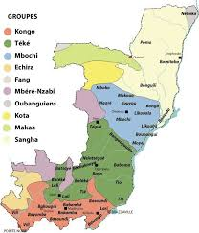
Effects of Colonization on the African People
Political
Laws in some colonies separated Native black Africans from white colonizers
Europeans used existing government to rule (indirect rule)
New borders took no account of the existing borders
An existing kingdom or ethnic group might be divided among several new colonies
Enemy ethnic groups might now be forced together in a new country
Why is this problematic?

Slide 20
Effects of Colonization on the African People
ANY POSITIVES?
Medicine
Modern agriculture
Ports and railways
Technology
Health and hygiene
Education made it possible for more foreign trade
Legal principals
Exposed to democracy

Slide 21
Imperialism and Colonization of Africa
Lesson 4
Rebellions and aftermath in the 20th Century

Slide 22
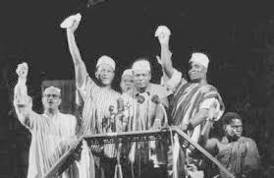
Decolonization
Africa had been divided up by the Europeans
No account taken for enemy tribes, languages or cultures already established
Now that Europeans were leaving, the joy of Nationalism was short lived
Africans basically had to figure out how to govern themselves
But who would rule? The smart and educated or the strong militia?
What language would they speak? What rules would they follow?
Who would make the laws?
How would the economy work (there was no industrialization or the means to create it)
RESULT: DEATH, CIVIL WAR-STILL HAPPENING TODAY IN CERTAIN COUNTRIES

Slide 23
Statement vs. Fact?
Africa was stripped of its natural resources and unfairly left without any manufacturing capability.
Railways and canals were built across the continent connecting plantations and mines to ports. When Europe left Africa (decolonized) Africa had no manufacturing infrastructure, no industry and no capital.

